Slide 1
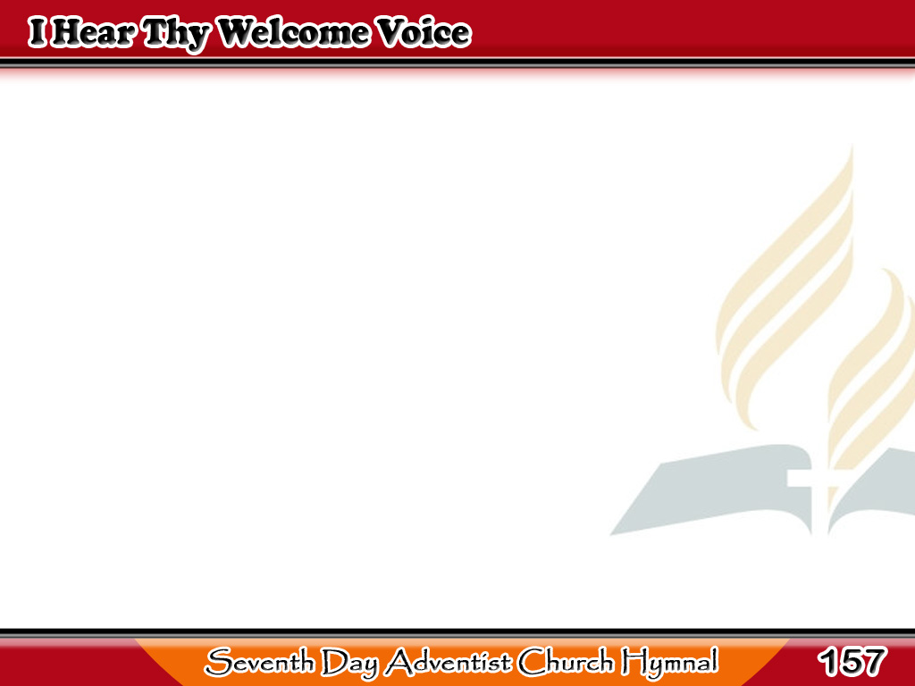
Tawag Mo’y Narinig
I hear Thy welcome voice,
That calls me, Lord to Thee;
For cleansing in Thy
precious blood,
That flowed on Calvary.
1/4

Slide 2
-Refrain-
Tawag Mo’y Narinig
I am coming, Lord!
Coming now to Thee!
Wash me, cleanse me,
in the blood
That flowed on Calvary.
1/4

Slide 3
Tawag Mo’y Narinig
Though coming weak and vile,
Thou dost my strength assure;
Thou dost my vileness
fully cleanse,
Till spotless all, and pure.
2/4

Slide 4
-Refrain-
Tawag Mo’y Narinig
I am coming, Lord!
Coming now to Thee!
Wash me, cleanse me,
in the blood
That flowed on Calvary.
2/4

Slide 5
Tawag Mo’y Narinig
‘Tis Jesus calls me on
To perfect faith and love,
To perfect hope,
and peace, and trust,
For earth and heaven above,
3/4

Slide 6
-Refrain-
Tawag Mo’y Narinig
I am coming, Lord!
Coming now to Thee!
Wash me, cleanse me,
in the blood
That flowed on Calvary.
3/4

Slide 7
Tawag Mo’y Narinig
All hail, atoning blood!
All hail, redeeming grace!
All hail! the gift of Christ,
our Lord,
Our Strength and Righteousness.
4/4

Slide 8
-Refrain-
Tawag Mo’y Narinig
I am coming, Lord!
Coming now to Thee!
Wash me, cleanse me,
in the blood
That flowed on Calvary.
4/4

